Slide 1
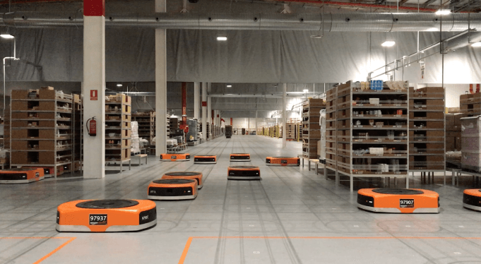
Amazon Robotics machines in a Amazon warehouse
Collision avoidance and coordination for a fleet of robots
Luca Marseglia

Slide 2
Summary
Context
Algorithm
Issues & Future work
2024 August | Slide 2

Slide 3
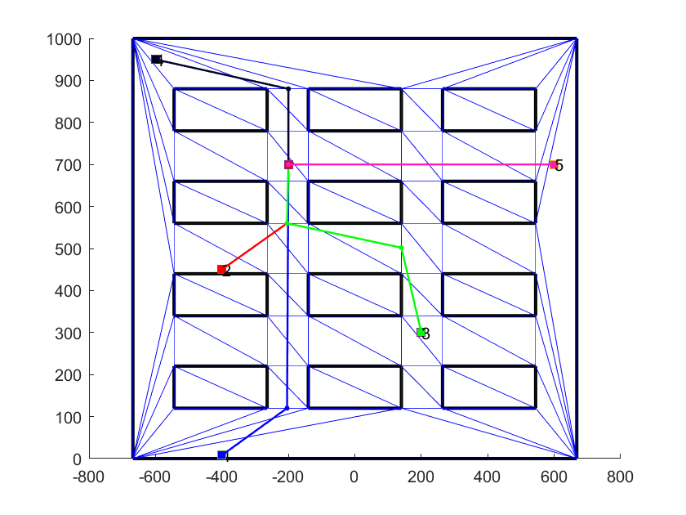
Modified CDT-RRT*
First, the CDT-RRT* has been modified to only choose the sample points in the middle of the edges.
2024 August | Slide 3

Slide 4
Context
The goal is to avoid collisions between robots at the end of their path, when they start to follow common trajectories, in a coordinated fashion.
The previous approach aimed at changing the maximum velocity of the robots along the whole path to achieve this task.
2024 August | Slide 4

Slide 5
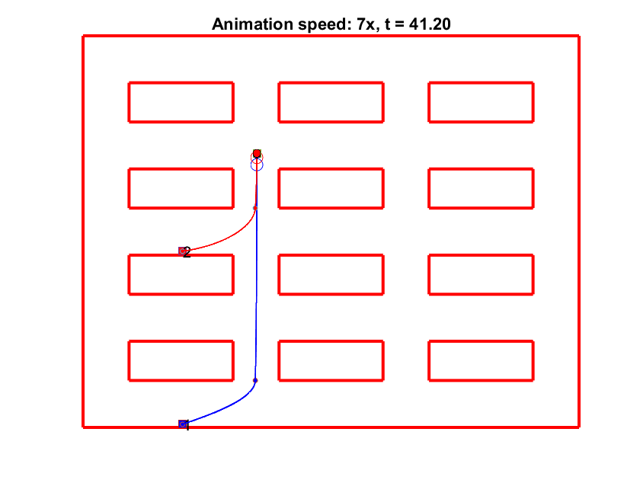
Simple case
But the previous approach had some drawbacks.
For this reason, the current approach aims at changing only the velocity of the robots in the segments that are involved in the collisions.
In particular, for this time, only collisions in the last segments are solved.
2024 August | Slide 5

Slide 6
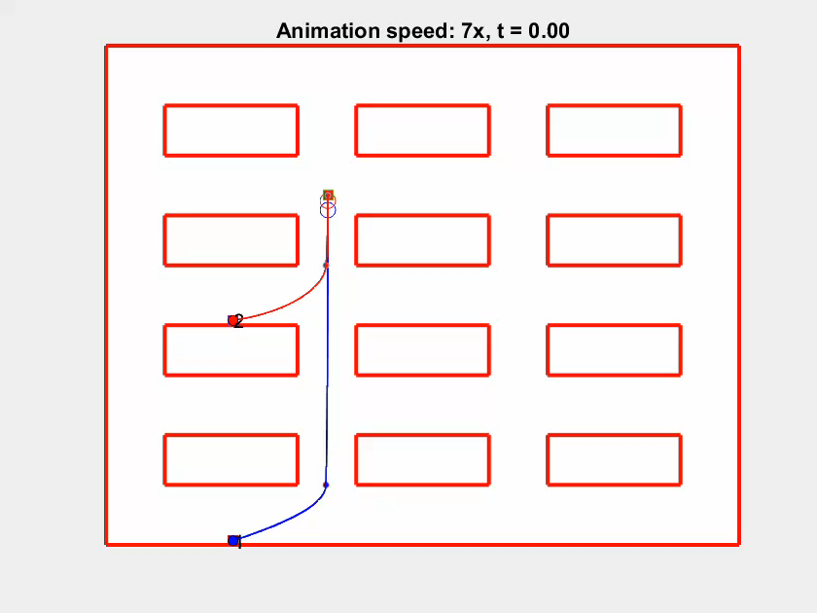
Simple case
Starting from the simplest case with two robots, the idea of the algorithm is to slow down the robot that is further from the goal at the instant of the collision (in this case, the blue robot).
This is because, if the opposite is done, in most of the cases collision becomes unavoidable.
2024 August | Slide 6

Slide 7
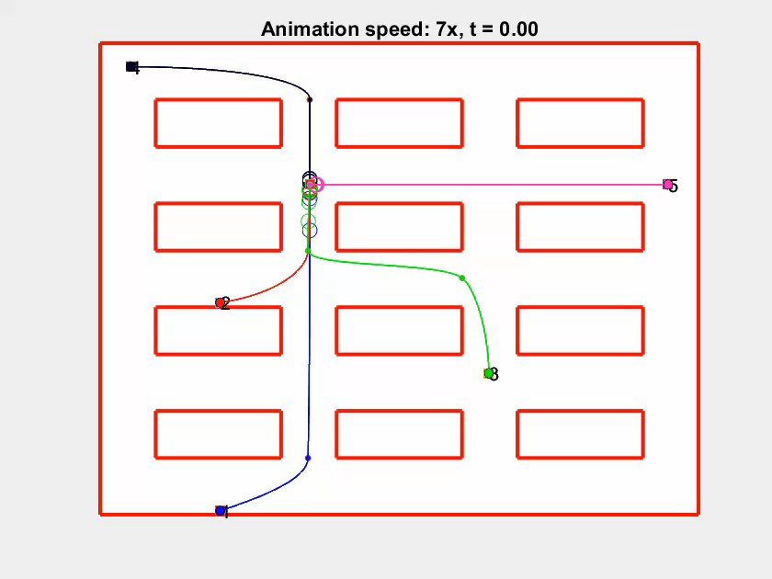
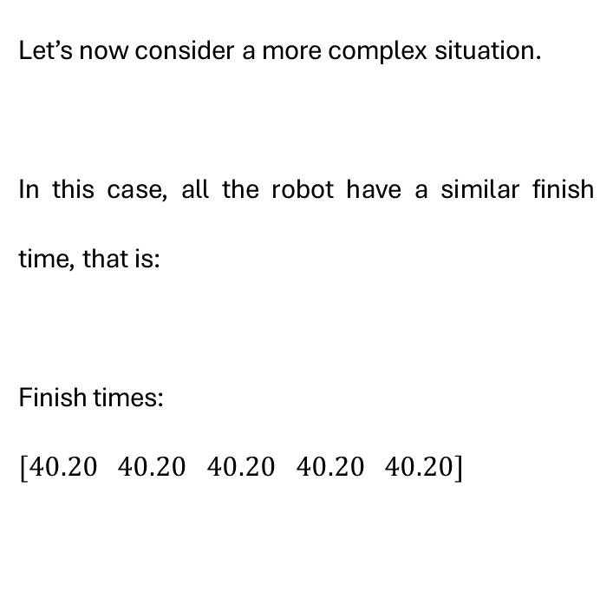
Collisions between 5 robots
Let’s now consider a more complex situation.
In this case, all the robot have a similar finish time, that is:
Finish times:
$$[40.20 40.20 40.20 40.20 40.20]$$
2024 August | Slide 7

Slide 8
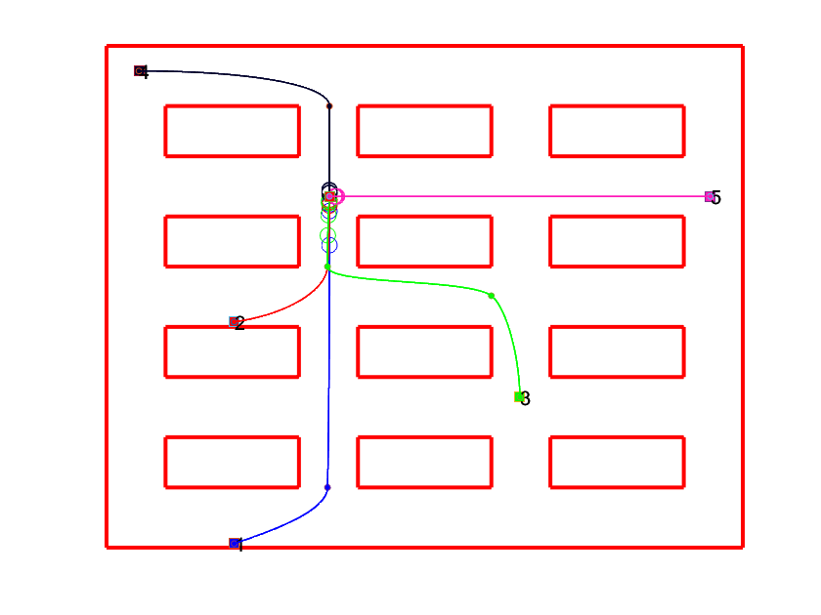
Steps
The algorithm iteratively looks for the furthest robot among the collisions and increases its travel time by 1 for that segment.
increasedTimes = 1 0 0 0 0
increasedTimes = 1 0 1 0 0
increasedTimes = 2 0 1 0 0
increasedTimes = 2 0 2 0 0
increasedTimes = 3 0 2 0 0
[…]
2024 August | Slide 8

Slide 9
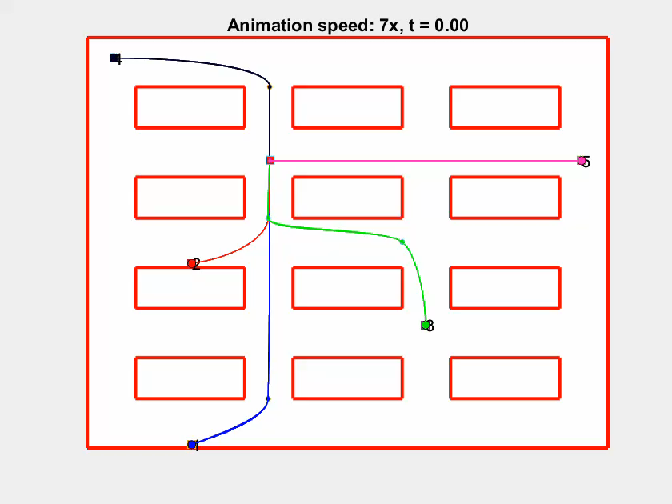

Without collisions
Finish times:
$$[45.20 40.20 44.20 42.20 47.20]$$
2024 August | Slide 9

Slide 10
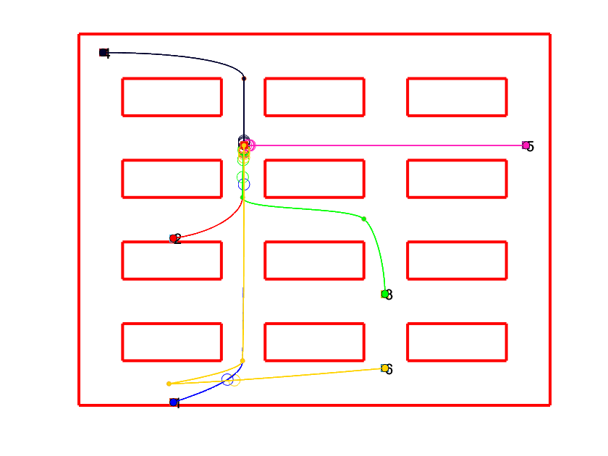
Issues & Future work
This algorithm doesn’t work for the other segments different from the last one.
Or, at least, a similar version could be developed for them.
2024 September | Slide 10

Slide 11
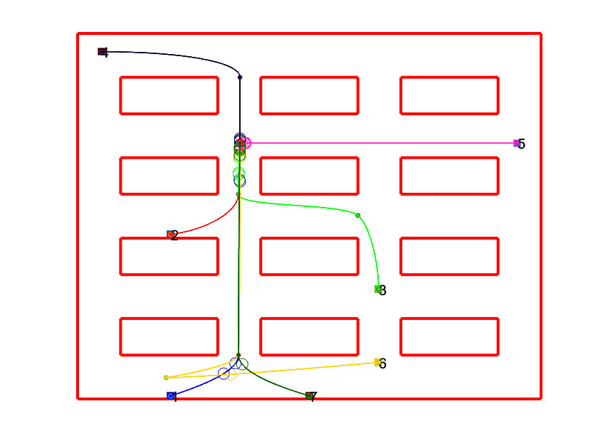
Issues & Future work
But the problem might not be so immediate, because if the velocity of a robot is changed only for a segment, this change could generate new collisions with other intersecting segments.
2024 September | Slide 11

